Slide 1

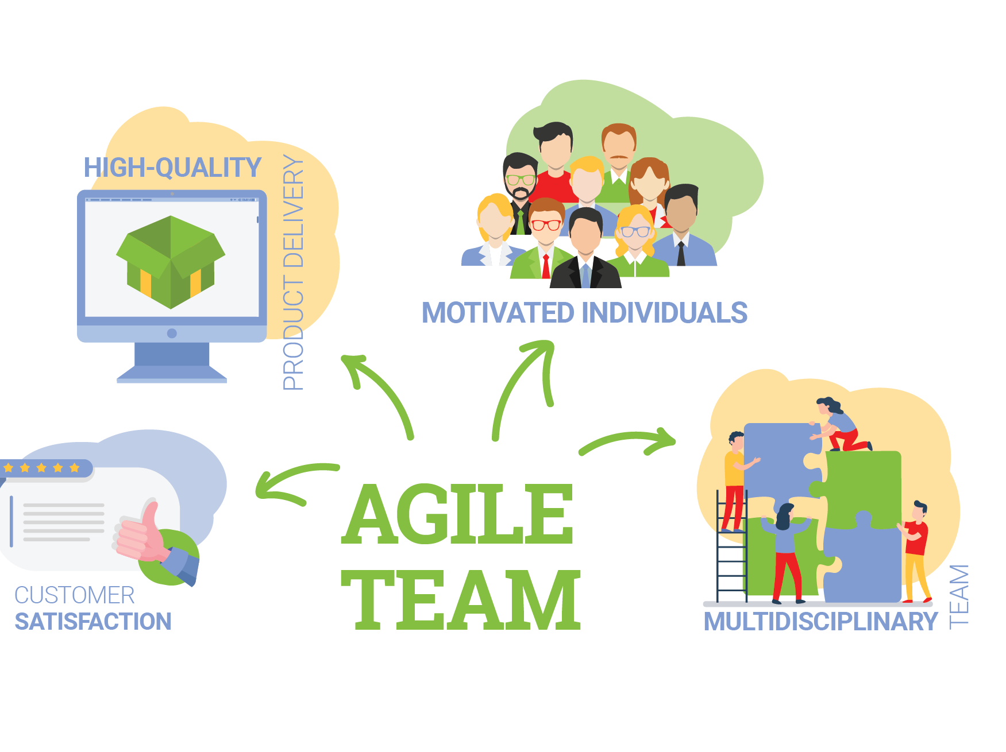
Agile Development
By Andrew Galipeau
This Photo by Unknown Author is licensed under CC BY-SA-NC

Slide 2
Agile Roles
Product Owner:
- Manages the product backlog and prioritizes work by customer needs.
They are to ensure the team delivers the product that meets user needs and aligns with the business goals.
Scrum Master:
Facilitates the Scrum processes/events.
Helps the team follow the Scrum principles and in improving skills.
Development Team:
Creates and tests the product increments.
The team delivers working increments of the product.
Contribute to sprint planning and reviews.

Slide 3
Agile Phases
Initiation
Foundation of the project
Includes the building of the initial product backlog
Planning
Focusing on details and the organization of the project.
Estimating and prioritizing backlog items.
Execution
Development team starts work on user stories.
Daily stand-up meetings during each sprint.
Constant testing and feedback.
Review and Retrospective
Evaluation of the progress made during the sprint.
Allows for stakeholders to give any feedback, for adjustments.
Closure
Final product review
Acceptance of requirements
Feedback on what could be changed for future projects, what went well and what didn’t.

Slide 4
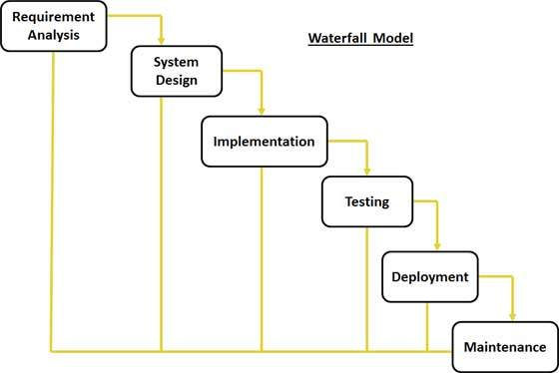
Waterfall Model
Waterfall Model is a linear and sequential approach where each phase must be completed before the next one can start.
Phases:
Requirements: Detailed documents of what is needed.
Design: Technical design of product.
Implementation: Building of the product.
Verification: Testing and validating requirements are met.
Maintenance: Post-deployment support and fixes.
This Photo by Unknown Author is licensed under CC BY-SA

Slide 5
Waterfall or agile approach
During my experience during the SNHU Travel project, the Agile approach had worked seamlessly. It had allowed for incremental development and quick adaptation to changes. If we had used the Waterfall approach, it would have required a complete redesign and testing.
Key Features | Agile | Waterfall
Flexibility | Iterative, adaptive to change. | Rigid, costly changes.
Customer Involvement | Continuous feedback and collaboration. | Limited to initial requirements and end testing.
Risk Management | Risks managed thru regular updates and iterations. | Risks being late in the process

Slide 6
Sources
What Is Scrum | Guide to the Most Popular Agile Framework. www.scrumalliance.org/about-scrum.
SDLC - Waterfall Model. www.tutorialspoint.com/sdlc/sdlc_waterfall_model.htm.
Scrum Guide | Scrum Guides. scrumguides.org/scrum-guide.html#team.
Comeau, Lesley. “Mastering Efficiency: The Key Stages of the Agile Software Development Life Cycle.” Scopic, 25 Mar. 2024, scopicsoftware.com/blog/mastering-efficiency-the-key-stages-of-the-agile-software-development-life-cycle.

